Slide 1

Parallel Programming in C with MPI and OpenMP
Michael J. Quinn

Slide 2
Chapter 15
The Fast Fourier Transform

Slide 3
Outline
Fourier analysis
Discrete Fourier transform
Fast Fourier transform
Parallel implementation

Slide 4
Discrete Fourier Transform
Many applications in science, engineering
Examples
  Voice recognition
  Image processing
Straightforward implementation: Θ(n²)
Fast Fourier transform: Θ(n log n)

Slide 5
Fourier Analysis
Fourier analysis: Represent continuous functions by potentially infinite series of sine and cosine functions
Discrete Fourier transform: Map a sequence over time to another sequence over frequency
  Signal strength as a function of time ⇒
  Fourier coefficients as a function of frequency

Slide 6
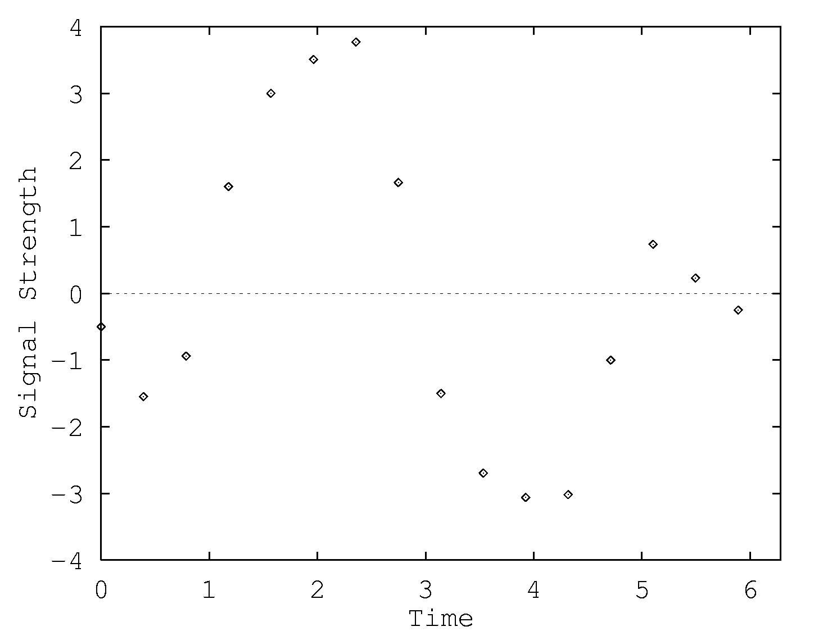
DFT Example (1/4)
16 data points representing signal strength over time

Slide 7
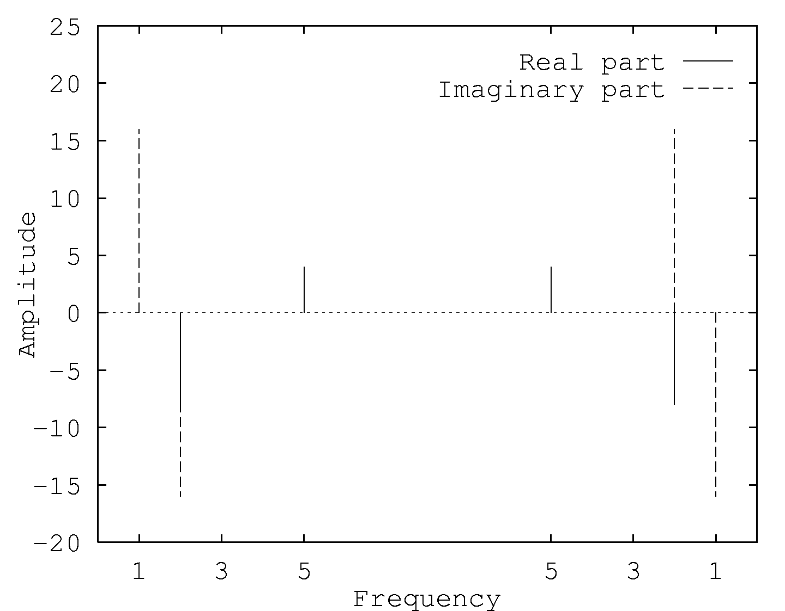
DFT Example (2/4)
DFT yields amplitudes and frequencies of sine/cosine functions

Slide 8
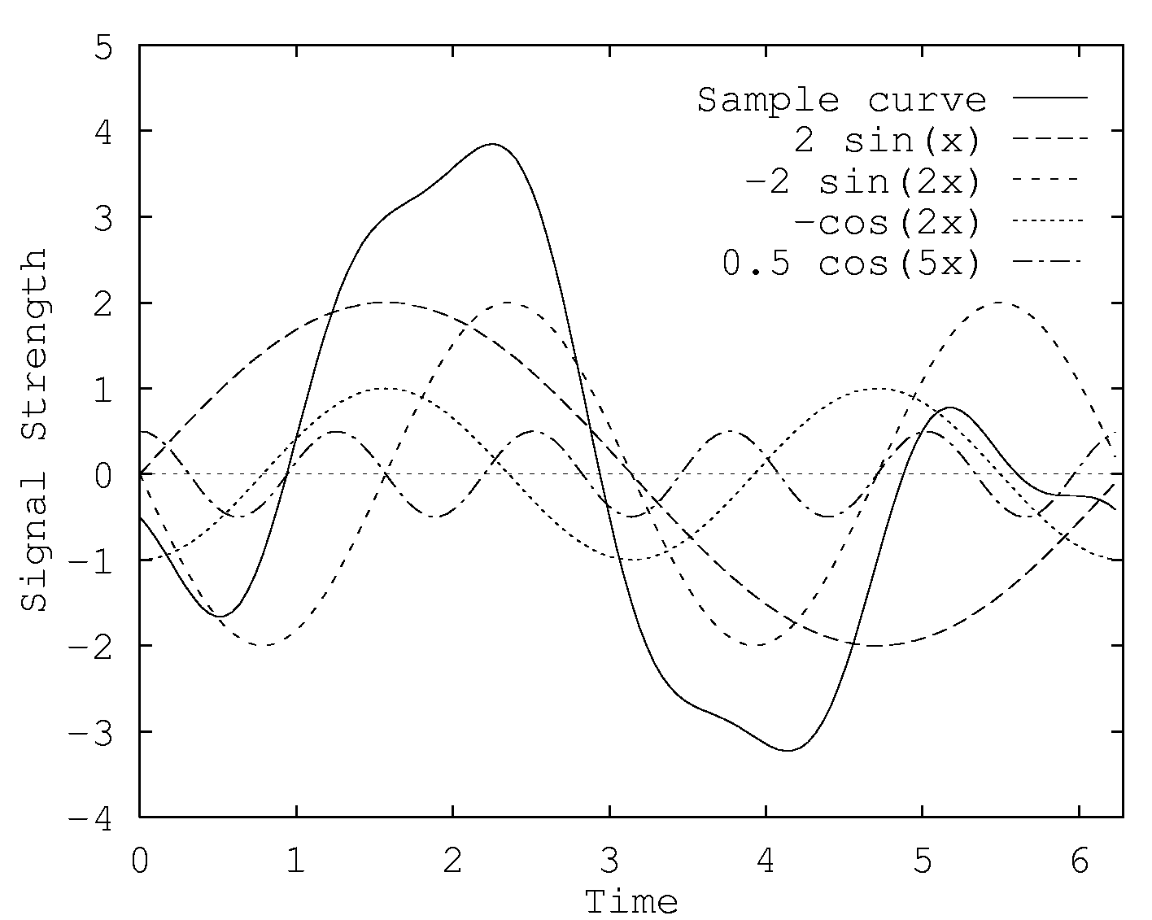
DFT Example (3/4)
Plot of four constituent sine/cosine functions and their sum

Slide 9
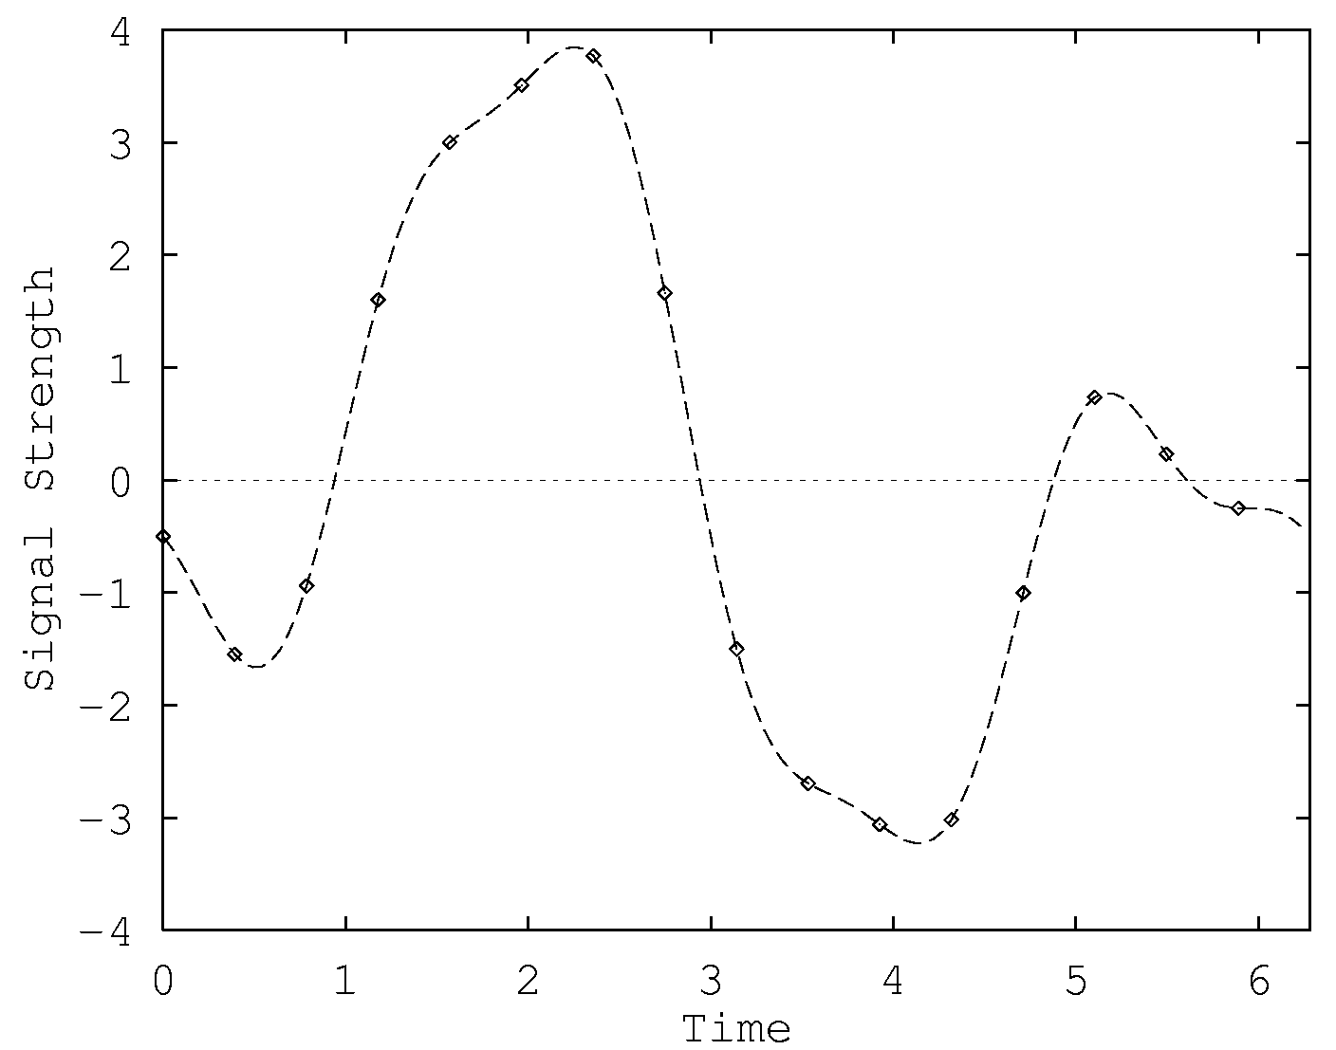
DFT Example (4/4)
Continuous function and original 16 samples.

Slide 10
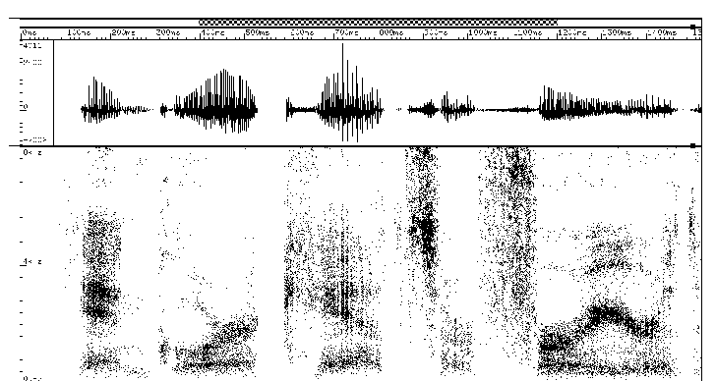
DFT of Speech Sample
“An gorra cats are furrier...”
Signal
Frequency
and amplitude
Figure courtesy Ron Cole and Yeshwant Muthusamy of the Oregon Graduate Institute

Slide 11
Computing DFT
Matrix-vector product F_{n} x
  x is input vector (signal samples)
  f_{i,j} = ω_{n}^{ij} for 0 ≤ i, j < n and ω_{n} is primitive nth root of unity

Slide 12
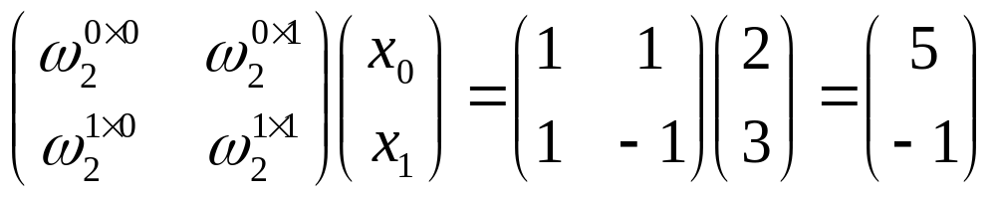
Example 1
Compute DFT of vector (2, 3)
ω₂, the primitive square root of unity, is -1

Slide 13
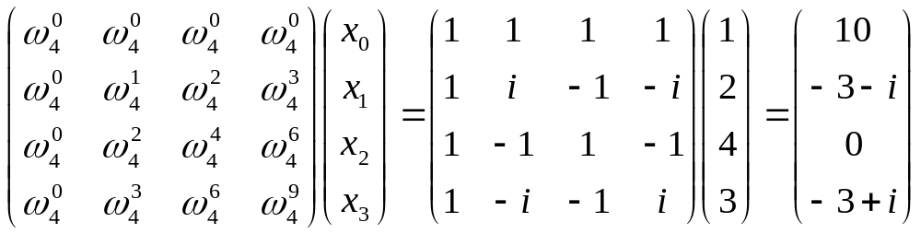
Example 2
Compute DFT of vector (1, 2, 4, 3)
The primitive 4th root of unity is i

Slide 14
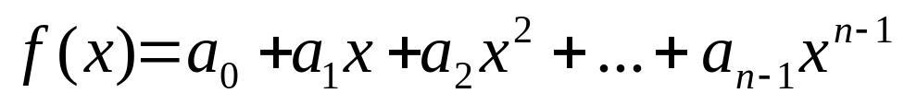
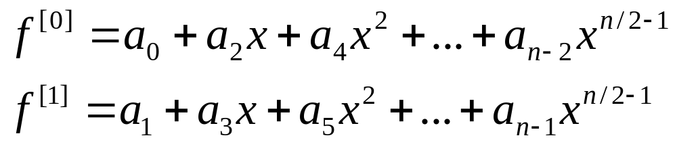
Fast Fourier Transform
An Θ(n log n) algorithm to perform DFT
Based on divide-and-conquer strategy
Suppose we want to compute f(x)
We define two new functions, f^{[0]} and f^{[1]}

Slide 15
FFT (continued)
Note: f(x) = f ^{[0]}(x²) + x f ^{[1]}(x²)
Problem of evaluating f (x) at n values of ω reduces to
  Evaluating f ^{[0]}(x) and f ^{[1]}(x) at n/2 values of ω
  Performing f ^{[0]}(x²) + x f ^{[1]}(x²)
Leads to recursive algorithm with time complexity Θ(n log n)

Slide 16
Iterative Implementation Preferable
Well-written iterative version performs fewer index computations than recursive version
Iterative version evaluates key common sub-expression only once
Easier to derive parallel FFT algorithm when sequential algorithm in iterative form

Slide 17
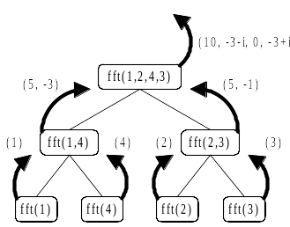
Recursive ⇒ Iterative (1/3)
Recursive implementation of FFT

Slide 18
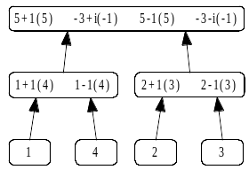
Recursive ⇒ Iterative (2/3)
Determining which computations are performed
for each function invocation

Slide 19
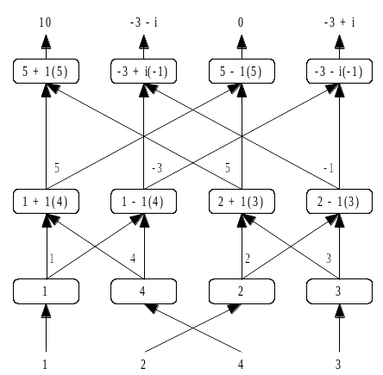
Recursive ⇒ Iterative (3/3)
Tracking the flow of data values (input vector at bottom)

Slide 20
Parallel Program Design
Domain decomposition
  Associate primitive task with each element of input vector a and corresponding element of output vector y
Add channels to handle communications between tasks

Slide 21
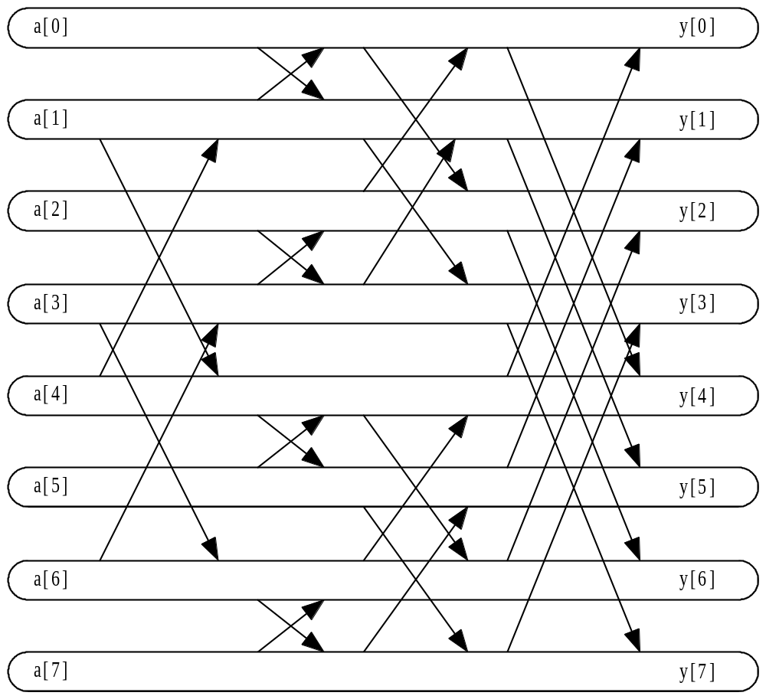
FFT Task/Channel Graph

Slide 22
Agglomeration and Mapping
Agglomerate primitive tasks associated with contiguous elements of vector
Map one agglomerated task to each process

Slide 23
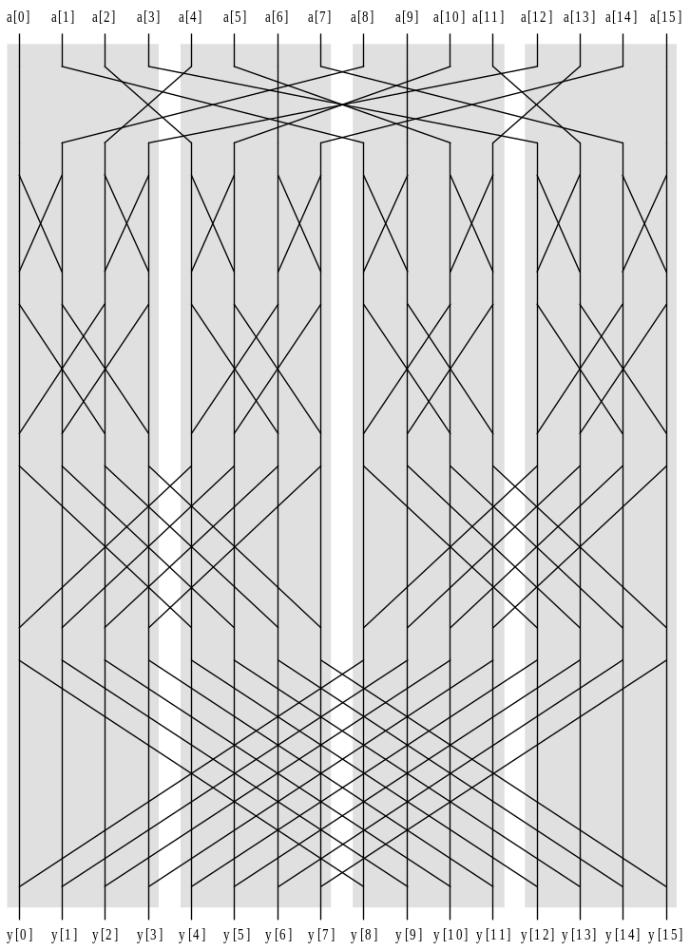
After Agglomeration, Mapping
Input
Output

Slide 24
Phases of Parallel FFT Algorithm
Phase 1: Processes permute a’s (all-to-all communication)
Phase 2:
  First log n – log p iterations of FFT
  No message passing is required
Phase 3:
  Final log p iterations
  Processes organized as logical hypercube
  In each iteration every process swaps values with partner across a hypercube dimension

Slide 25
Complexity Analysis
Each process performs equal share of computation: Θ(n log n / p)
All-to-all communication: Θ(n log p / p)
Sub-vector swaps during last log p iterations: Θ(n log p / p)

Slide 26
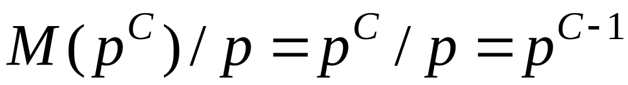
Isoefficiency Analysis
Sequential time complexity: Θ(n log n)
Parallel overhead: Θ(n log p)
Isoefficiency relation:
n log n ≥ C n log p ⇒ log n ≥ C log p ⇒ n ≥ p^{C}
Scalability depends C, a function of the ratio between computing speed and communication speed.

Slide 27
Summary
Discrete Fourier transform used in many scientific and engineering applications
Fast Fourier transform important because it implements DFT in time Θ(n log n)
Developed parallel implementation of FFT
Why isn’t scalability better?
  Θ(n log n) sequential algorithm
  Parallel version requires all-to-all data exchange

